Slide 1
Unit 2
What time do you go to school?

Slide 2
get up
起床
Phrases:
eat breakfast
吃早饭
take a bus
乘车
go to school
去上学
have a class
上课
have lunch
吃午饭
play sports
做运动/进行体育活动
go home
回家
have dinner
吃晚饭
do homework
做作业
watch TV
看电视
take a shower
洗澡
go to bed
睡觉

Slide 3
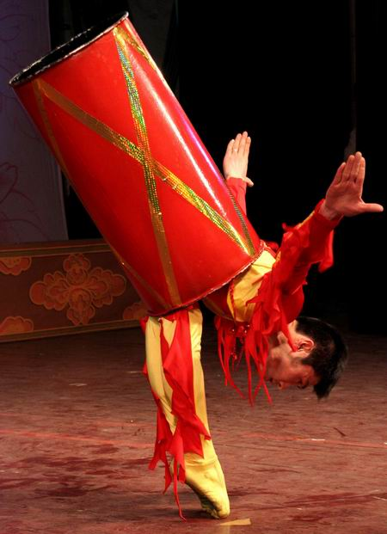
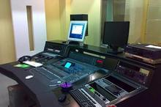
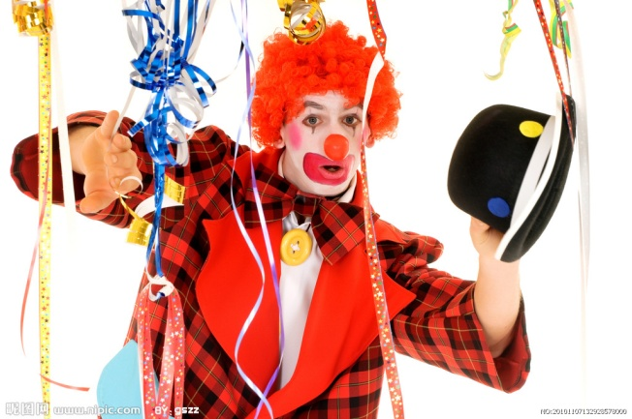
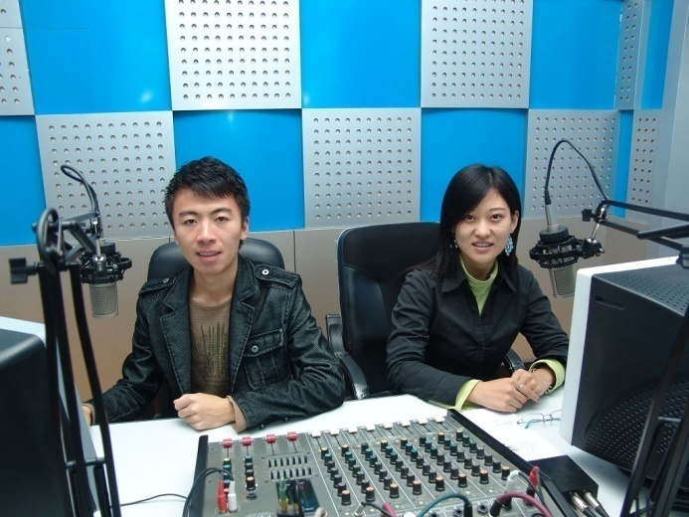
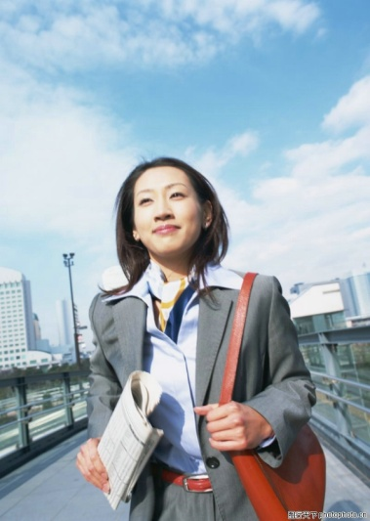
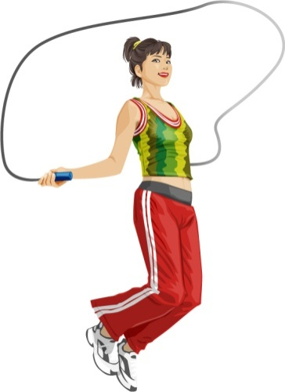
New words of 2d
funny
radio station
an interesting job
radio show
exercise
go to work

Slide 4



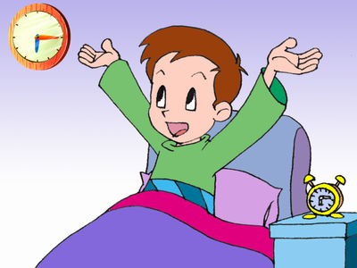

What time is it?
It’s 7 o’clock.
I always get up at 7 o’clock.

Slide 5
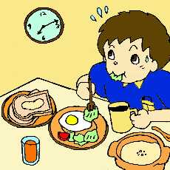
What time is it?
It’s 7:15.
I usually eat breakfast at seven fifteen.

Slide 6
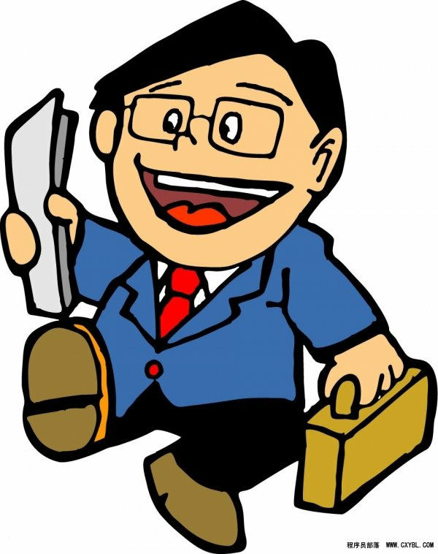
What time is it?
It's 7:30
I never go to work at seven thirty.

Slide 7
Let's talk about our busy morning.
morning activities
早晨活动
What time do you usually …?

Slide 8
Free talk:
A: What time do you usually…?
get up
get dressed
brush teeth
eat breakfast
go to school
6:00
6:20
6:30
7:10
7:20
B: I usually...at…
D: What time do you usually…?
C: I usually...at…

Slide 9
Guess （猜一猜）：
Scott
Where does Scott work ?
He works at .
Look at the picture and guess the answer.
He works at a radio station.

Slide 10
Guess （猜一猜）：
Scott
What time does Scott get up ?
He gets up at .
Read the conversation in 2d and find the answer.
He gets up at 8:30 at night.

Slide 11
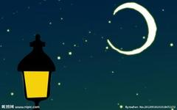
He gets up at 8:30 at night
Very Strange !
奇怪
Read the conversation in 2d
让我们一起来找到Scott 奇怪行为的原因吧。

Slide 12
Let's read
(请注意断句，以及语音语调)
Interviewer(记者)：Scott has an interesting job.He works at a radio station .Scott,What time is your radio show ?
Scott :From twelve o'clock at night to six o'clock in the morning.
Interviewer: What time do you usually get up?
Scott:At eight thirty at night.Then I eat breakfast at nine.
Interviewer: That's a funny time for breakfast!
Scott:Yeah.After that ,I usually exercise at about ten twenty.
Interviewer:When do you go to work ?
Scott:At eleven o'clock, so I'm never late for work .

Slide 13
Reading
Read the conversation in 2d. Fill in the blanks.
get up
eat breakfast
exercise
go to work
radio show
Activities
time
at eight thirty at night
at nine
at about ten twenty
at eleven
from twelve o’clock at night to six o’clock in the morning

Slide 14
But I never get up at 8:30 at night.
I always get up at 6:00 in the morning.
I usually eat breakfast at 6:30 in the morning .
Grammar
Focus
always（总是） =100%
usually（通常） =80%
never（从不） =0%
它们是频率副词，表示动作发生的频率。
它们放在句中什么位置？
I usually get up at 6:30.
They always get dressed at 7:20.
He always goes to work at 11：00.
He is never late .
They usually exercise on weekends.
它们经常放在系动词be之后，或实义动词之前。

Slide 15
Tom's school days
 | Monday | Tuesday | Wednesday | Thursday | Friday
get up | 6:00 | 6:00 | 6:00 | 6:00 | 6:00
eat breakfast | 6:20 | 6:20 | 6:20 | 6:20 | 6:30
go to school | 7:00 | 7:00 | 7:00 | 7:00 | 7:00
Complete the sentences with always, usually or never.
1. Tom gets up at 6:00 from Monday to Friday.
2. He eats breakfast at 6:20.
3. He eats breakfast at 6:20 on Friday.
4. He goes to school at 7:00.
5. He is late for school.
always
usually
never
always
never

Slide 16

Three ways
to express the same time
1. 点钟数 + 分钟数
eg: 6: 15
7: 29
six fifteen
seven twenty-nine
2. 分钟数 + past +点钟数
(分钟数不超过30分)
eg: 6: 15
7: 29
8: 30
a quarter past six
twenty-nine past seven
half past eight
3. 差分钟数 + to +下一点钟数
(分钟数超过30分)
eg: 5: 45
9: 39
a quarter to six
twenty-one to ten

Slide 17
正点 o’clock
时间表达法
30分钟以后 to
30分钟以内 past
刚好30分钟half past
点钟数
点钟数
3. half past _______
1.______ o’clock
分钟数
2. ______ past _______
点钟数
差分钟数
4. ________ to _________
下一点钟数
5. 15分钟 a quarter past
点钟数
下一点钟数
6. 45分钟 a quarter to

Slide 18
Two ways of telling the time :
7:00
7:05
7:10
7:15
7:25
7:30
7:35
7:40
7:45
7:50
seven/seven o’clock
seven o five/five past seven
seven ten/ten past seven
seven fifteen/a quarter past seven
seven twenty-five/twenty-five past seven
seven thirty/ half past seven
seven thirty-five/twenty-five to eight
seven forty/ twenty to eight
seven forty-five/a quarter to eight
seven fifty/ten to eight

Slide 19
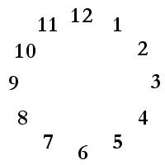
What time is it , please?
It’s five past two .
It’s two (o )five .

Slide 20
What time is it , please?
It’s seven fifteen .
It’s a quarter past seven .

Slide 21
What time is it , please?
It’s two to two .
It’s one fifty-eight .

Slide 22
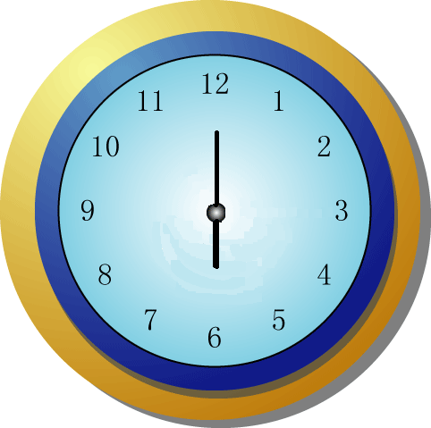


What time is it now?
It’s six a.m.
It’s six o’clock in the morning.
6:00
It’s six p.m.
It’s six o’clock in the afternoon.
18:00

Slide 23

I usually go to school at 7:00.
否定句
I don’t go to school at 7:00.
一般疑问句
Do you go to school at 7:00.
Yes, I do.
No, I don’t.
What time do you usually go to school?

Slide 24
He usually goes to school at 7:00.
否定句
He doesn’t go to school at 7:00.
一般疑问句
Does you go to school at 7:00?
Yes, he does.
No, he doesn’t.
What time does he usually go to school?

Slide 25
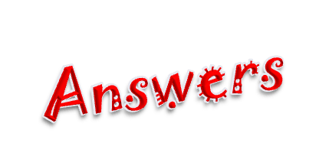
1. What time do you get up on school days?
_______________________________
2. ______________________________?
Rick always gets up at 6:20.
3. What time do you have breakfast?
___________________________________
4. _______________________________？
Anna never eats breakfast.
5. What time does your best friend go to school?
_______________________________
I usually get up at ...
What time does Rick get up
I usually have breakfast at ...
What time does Anna eat breakfast
He/She usually goes to school at ...

Slide 26

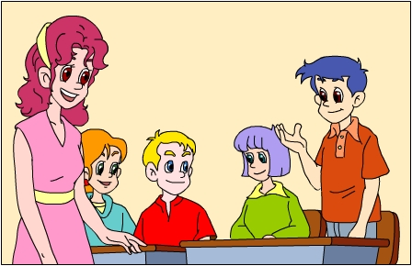
Talk about something you always do,
Something you usually do and something you never do.
A: I always… I usually… I never…
B: I always… I usually… I never…
C: I always… I usually… I never…
D: I always… I usually… I never…

Slide 27
3c Interview your classmates. Find out what time she/he does these activities. Then give a report to the class.
 | stuedent 1 | student 2 | student 3
get up
exercise
eat dinner
take a shower
go to school
What time do you usually…?
Report : My friend Bill gets up at …. He eats breakfast at…. He goes to school at…

Slide 28

Give a report to the class.
In our group, Jenny usually gets up late on weekends. She gets up at …
____________________________________
____________________________________
____________________________________
____________________________________
___________________________
seven o’clock. She always exercises at eight o’clock. She usually eats dinner at six thirty.
She usually takes a shower at nine o’clock.
She usually goes to school at seven thirty on school days.
In our group, A… B… C…

Slide 29
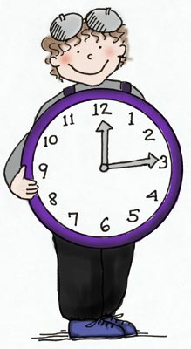

Homework
If you are free this Saturday, please arrange it as you like it to be. (这个周六你若可以自由支配，请你设计出你喜欢的活动，并根据这些内容写一篇以“My Day”为题的作文。)
Time
Activity

